Slide 1
Aggregate Query and Analysis While Maintaining Personally Identifying Information Privacy
Andrew N. Abbott, anabbott@smu.edu, MSDS 7330

Slide 2
Introduction
Many electronic record keeping systems necessarily collect personally identifiable information (PII), such as social security numbers, dates of birth, or addresses.
Analysts and business users of reports and data warehouses are often able to query user’ PII directly, putting customers at risk.
The task of protecting that PII from theft, abuse or negligence is of vital importance.
It is also important to be able to analyze the data in ways that combine user’ information together to do things like intelligent disease cluster identification or anomaly detection.

Slide 3
What is PII?
“Any information that distinguishes one person from another can be used for re-identifying anonymous data [1].”
Any information related to a person that distinguished one person from another and is not generated solely by the enterprise.
A. Narayanan, V. Shmatikov. (2010, June). Privacy and Security, Myths and Fallacies of “Personally Identifiable Information”. Communications of the ACM. [Online]. 53(6), pp. 24-26. Available: https://www.cs.utexas.edu/~shmat/shmat_cacm10.pdf

Slide 4
Examples
Name, such as full name, maiden name, mother‘s maiden name, or alias
Personal identification number, such as social security number (SSN), passport number, driver‘s license number, taxpayer identification number, or financial account or credit card number
Address information, such as street address or email address
Personal characteristics, including photographic image (especially of face or other identifying characteristic), fingerprints, handwriting, or other biometric data (e.g., retina scan, voice signature, facial geometry)
Information about an individual that is linked or linkable to one of the above (e.g., date of birth, place of birth, race, religion, weight, activities, geographical indicators, employment information, medical information, education information, financial information).[1]
Guide to Protecting the Confidentiality of Personally Identifiable Information (PII), NIST Special Publication 800-122, 2010.

Slide 5
Dangers
Breaches involving PII are hazardous to both individuals and organizations.
Individual harms may include identity theft, embarrassment, or blackmail.
Organizational harms may include a loss of public trust, legal liability, or remediation costs.

Slide 6
Methods
De-identifying the data.
PII is removed or obscured such that remaining data does not identify an individual. De-identified data may be re-identified by using a code or algorithm.
Anonymizing the data.
Information that has been de-identified and a code for re-identification does not exist.
Differential Privacy.
Computations are indistinguishable when run with and without any one record.
Secure-Query based approach.
A data owner publishes a query language and a portal allowing researchers to submit queries. Privacy enforced by the language interpreter.

Slide 7
Anonymizing Data
Privacy protection without adding fake or removing truthful information.
Information concerning both relational and transaction attributes may lead to identification.
K-anonymity provides minimal information loss.
Suppression
Generalization

Slide 8
Differential Privacy
C. Dwork, “Differential privacy,” in ICALP, 2006, pp. 1-12.
Various approaches to anonymizing records have failed when researchers managed to identify personal information by linking two or more separately anonymized databases.
Differential privacy is a framework for formalizing privacy in statistical databases introduced in order to protect against these kinds of de-anonymization techniques.
The presence or absence of an individual record will not affect the calculation output.

Slide 9
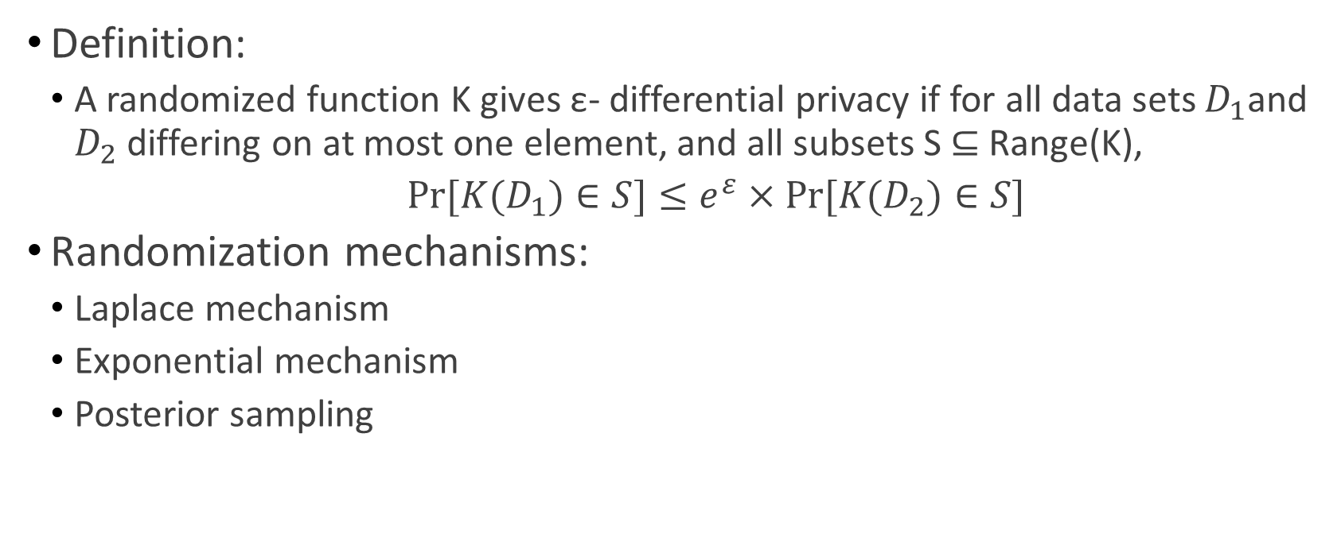
Differential Privacy
Definition:
A randomized function K gives ε- differential privacy if for all data sets $D_{1}$and $D_{2}$ differing on at most one element, and all subsets S ⊆ Range(K),
$Pr⁡[K(D_{1})∈S]≤e^{ε}×Pr⁡[K(D_{2})∈S]$
Randomization mechanisms:
Laplace mechanism
Exponential mechanism
Posterior sampling
Source: https://en.wikipedia.org/wiki/Differential_privacy

Slide 10
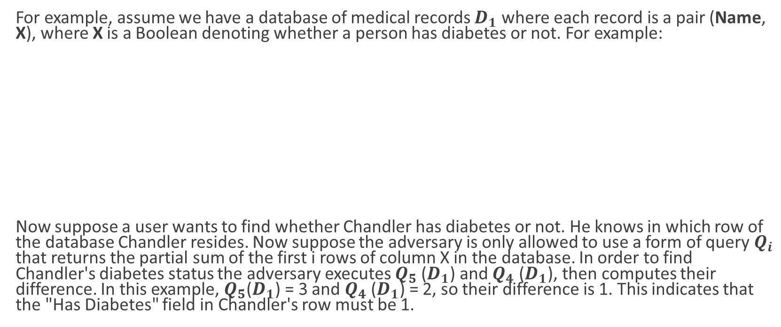
Differential Privacy - Example
For example, assume we have a database of medical records $D_{1}$ where each record is a pair (Name, X), where X is a Boolean denoting whether a person has diabetes or not. For example:
Now suppose a user wants to find whether Chandler has diabetes or not. He knows in which row of the database Chandler resides. Now suppose the adversary is only allowed to use a form of query $Q_{i}$ that returns the partial sum of the first i rows of column X in the database. In order to find Chandler's diabetes status the adversary executes $Q_{5}$($D_{1}$) and $Q_{4}$ ($D_{1}$), then computes their difference. In this example, $Q_{5}$($D_{1}$) = 3 and $Q_{4}$($D_{1}$) = 2, so their difference is 1. This indicates that the "Has Diabetes" field in Chandler's row must be 1.
Name | Has Diabetes (X)
Ross | 1
Monica | 1
Joey | 0
Phoebe | 0
Chandler | 1
Source: https://en.wikipedia.org/wiki/Differential_privacy

Slide 11
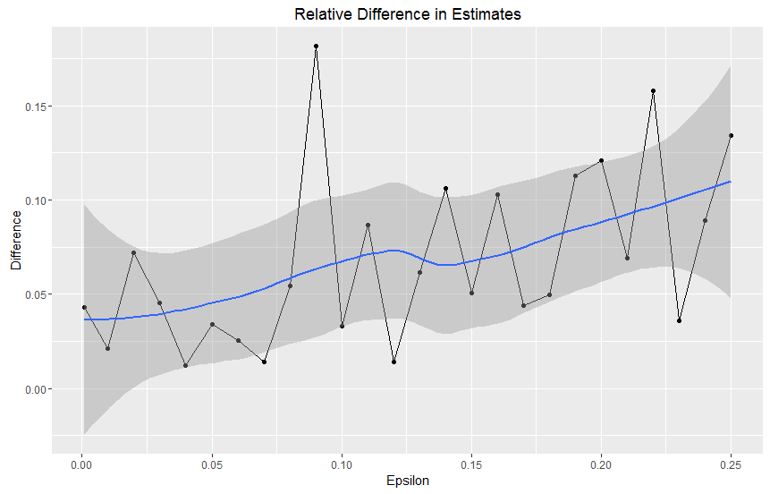
Differential Privacy - Example

Slide 12
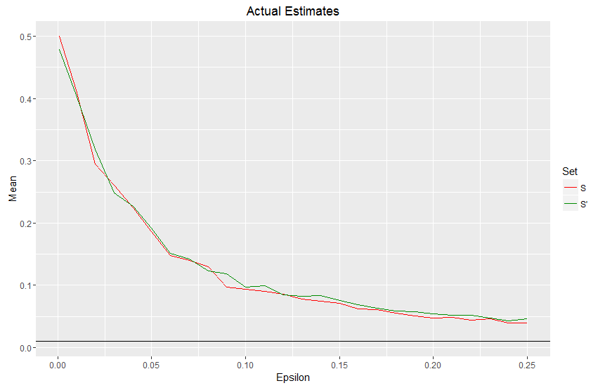
Differential Privacy - Example

Slide 13

Real-world usage
U.S. Census
Google RAPPOR
Apple iOS10
https://www.apple.com/pr/library/2016/06/13Apple-Previews-iOS-10-The-Biggest-iOS-Release-Ever.html

